Slide 1
The Flow of Food: Purchasing, Receiving, Storage
ServSafe Chapter 5 (7th edition)

Slide 2
General Purchasing and Receiving Principles
You cannot make unsafe food safe!
Purchase from approved, reputable suppliers

Slide 3
Purchasing
Buy only from approved, reputable suppliers
Should have inspection reports that you can obtain
Meet state, local and federal laws
Includes growers, shippers, packers, manufacturers, distributors, and local markets
Develop a relationship with suppliers
Many operations establish supplier lists based on company specs, standards and procedures
Deliveries should only be made when staff has enough time to do inspections. Schedule during off peak hours

Slide 4
Receiving and Inspecting
Make a specific staff member responsible for receiving and train them
Visually inspection of items and delivery vehicle
Temp check food and store immediately
Provide staff with tools to received correctly (scales and thermometers)
Make sure enough trained staff are available during deliveries.
Inspect immediately upon delivery/receipt

Slide 5
Receiving and Inspecting
Service that allows food to be delivered after-hours when closed for business.
Supplier is given a key or other access to building
Products are placed in coolers, freezers, and dry-storage areas
Delivery should be inspected once you arrive at operation and should meet following conditions
From approved supplier
Placed in correct storage
Protected from contamination in storage
Has not be contaminated
Is honestly presented
Key Drop Deliveries

Slide 6
Receiving and Inspection
If you must reject, set it aside
Tell the delivery person why you are rejecting
Get a signed adjustment sheet from delivery person
Log incident on invoice or receiving documents
Some items might be reconditioned (dirty cans can be cleaned)
Damaged must be sent back
Rejecting Items

Slide 7
Receiving and Inspection
Vendors should notify of recall
Also monitor FDA and USDA
Identify recalled food items by matching information from the recall notice to the item
Remove item from inventory and place in secure and appropriate place. Store separately from food, utensils, equipment, linens, and single-use items
Label item in a way that will prevent it from being placed back in inventory (Do Not Use, Do Not Discard)
Refer to the vendor’s notification or recall notice for what to do with item. (throw it out or return it)
Recalls

Slide 8
Receiving and Inspection
Use thermometers to check food temperature during receiving
Check meat, poultry and fish by inserting thermometer stem or probe directly into the thickest part of the food.
Check Reduced-oxygen packaging (ROP) food (modified atmosphere packaging [MAP], vacuum-packed, and sous vide food) by inserting the thermometer stem or probe between two packages. If package allows fold it around thermometer stem. DO NOT PUNCTURE PACKAGING!
Other packaged food should be opened and thermometer stem/probe should be inserted to cover sensing area.
Temperature

Slide 9
Delivery and Inspection
Food | Receiving Criteria
Cold TCS food (melons, sprouts, cut fruits/veggies) | 41 F or lower, unless otherwise specified
Live Shellfish | Air temp of 45 F and an internal temp no greater than 50 F
Shucked Shellfish | 45 F or lower Cool the shellfish to 41 F or lower in 4 hours
Milk | 45 F or lower Cool the milk or lower in 4 hours
Shell Eggs | Air temp of 45 F or lower
Hot TCS food | 135 F or higher
Frozen Food | Should be frozen solid when received. REJECT: fluids or water stains appear in case bottoms or packaging *or if there are ice crystals or frozen liquids on the food or the packaging…could be evidence of refreezing/thawing, or time/temp abuse
Delivery Temperatures

Slide 10
Receiving and Inspecting
Damage to Reject
items with tears, holes or punctures in packaging
Reject cans with:
Severe dents in seams
Deep dents in body
Missing labels
Swollen or bulging ends
Holes and visible signs of leaking
Rust
All food packaged in ROP/MAP is bloated or leaking
Items with broken cartons or seals
Dirty discolored packaging
Anything tampered with
Packaging

Slide 11
Reject
Liquid
Leaks, dampness or water stains
Pests
chewed edges, feces
Dates
incorrectly labeled food
missing use-by-date
missing expiration date
Items passed use-by-date or expiration date

Slide 12
Receiving and Inspection
Food items should be delivered with correct documents
Shellfish should be received with shellstock identification tags
Tell when and where shellfish were harvested and from approved source
Store shellfish in original container until last shellfish is used and then write date on shellstock tag and keep on file for 90 days for last use.
Fish eaten raw or partially cooked must be received with correct documentation.
Indicates fish were properly frozen before received
Kept 90 days from sale of fish
Farm raised fish should have FDA documentation
Documentation

Slide 13
Receiving and Inspection
Poor food quality can be a sign that food has been time-temp abused and unsafe
Appearance
Reject: moldy, abnormal color, moist when it should be dry, or show signs of pest infestation
Texture
Reject: meat, fish, or poultry that is slimy, sticky, or dry. If flesh leaves and imprint when touched
Odor
Reject: abnormal or unpleasant odor
Food Quality

Slide 14
Storing
All items that are not in their original containers
Food labels should include common name of food clearly and accurately
Labeling Food for use On-Site

Slide 15
Storing
Items packaged in an operation for sale to customers for home use should have the following indicated on label:
Common name of food or statement clearly identifying
Quantity of food
List of ingredients and sub-ingredients in descending order
List of artificial colors and flavors in food
Chemical preservatives
Name and place of business of manufacturer, packer, or distributor
Labeling Food that is package on-site for retail sale

Slide 16
Date Marking
Food must be date marked if it is held for longer than 24 hours
Should indicate when the food must be sold, eaten, or thrown out
Dates can be marked on prep day or use by day.
Only use one in your operation
RTE TCS food can be held for seven days at 41˚F or lower
Count begins on day food was prepared or container opened.
When combining food with different use-by dates in a dish, the discard date of dish should be base on the earliest use-by date of any food items involved.

Slide 17
Temperatures
Store cold TCS food at an internal temp of 41˚F or lower
Store hot TCS food at 135˚F or warmer
Storage units should have an air temperature measuring device in the warmest part of unit and it must be accurate within +/- 3˚F
Do not overload coolers/freezers
Monitor food temps regularly
Use open shelving (do not line shelves)

Slide 18
Rotation
First In First Out
Check expiration dates
Store items with earliest use-by date/expiration date in front and those with later dates in back
Use those that expire sooner, first
Throw out food passed its expiration date
FIFO

Slide 19
Preventing Cross Contamination
Storage:
Supplies are stored in designated storage areas
Stored 6 inches from walls and floors
Store single use items in original packaging
Containers
Never use empty food containers or chemical containers to store different items
Use durable, leak proof containers that can be sealed or covered
Clean and sanitize all surfaces and storage equipment regularly

Slide 20
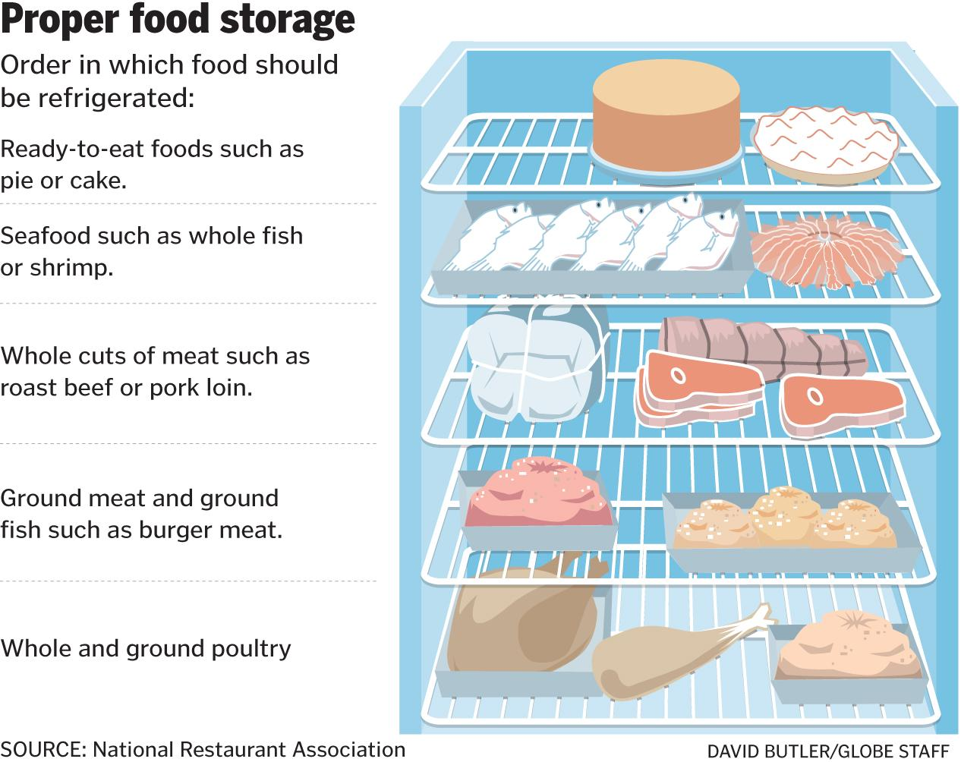
Storage Order

Slide 21
Storage Order
Store raw meat, poultry, and seafood separately from ready-to-eat food
If they cannot be stored separately then store by internal cooking temperature
Ground meat and ground fish can be stored above whole cuts of beef and pork.

Slide 22
Storage Location
Food should be stored in clean, dry location away from dust and other contaminants
Never store in the following:
Locker or dressing rooms
Restrooms or garbage rooms
Mechanical rooms
Under unshielded sewer lines or leaking water lines
Under stairwells

Slide 23
Damaged, Spoiled and incorrectly stored food
Discard damaged, spoiled or incorrectly stored food or food that becomes unsafe.
Missing dates, past date, exceeded time and temp
If it must be stored until it can be returned then store away from other food/equipment and label so it is not used by other food handlers.

